Slide 1


<Francisco Roman >
<12.04.2023>

Slide 2

Outline
Executive Summary
Introduction
Methodology
Results
Conclusion
Appendix

Slide 3
Executive Summary
Summary of methodologies:
Data Collection through API.
Data Collection with Web Scraping.
Data Wrangling.
Exploratory Data Analysis with SQL.
Exploratory Data Analysis with Data Visualization.
Interactive Visual Analytics with Folium.
Machine Learning Prediction.
Summary of all results:
Exploratory Data Analysis result.
Interactive analytics in screenshots.
Predictive Analytics result.

Slide 4
Introduction
The objective is to evaluate the viability of the new company Space Y to compete with SpaceX.
Problems you want to find answers:
The best way to estimate the total cost for launches,by predicting successful landings of the first stage ofrockets?
Where is the best place to make launches?.

Slide 5

Section 1

Slide 6
Methodology
Executive Summary
Data collection methodology:
Space X data was collected from two sources, SpaceX API and Web Scraping
Perform data wrangling
In the data we create a landing outcome label
Perform exploratory data analysis (EDA) using visualization and SQL
Perform interactive visual analytics using Folium and Plotly Dash
Perform predictive analysis using classification models
We loaded the data and transformed to use in our training and testing with different model of machine learning (logistic regression, support vector machine, decision tree and k nearest neighbors), to this we use GridSearchCV with various hyperparameters. We used accuracy of ours models to compare their values and obtain the best model.

Slide 7
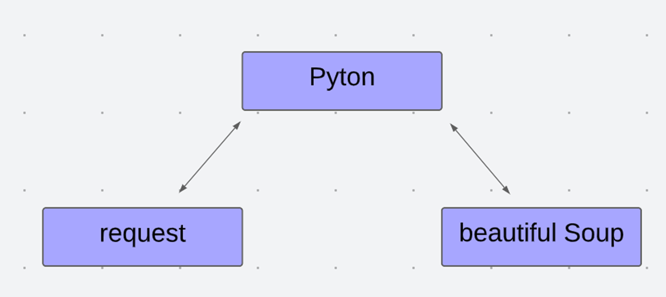
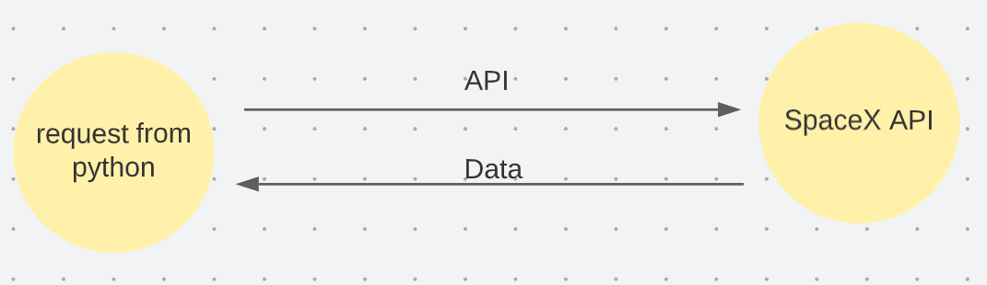
Data Collection
Describe how data sets were collected.
Data was collecting using API request to SpaceX API (https://api.spacexdata.com/v4/rockets/ ) and using web scraping to Wikipedia (https://en.wikipedia.org/wiki/List_of_Falcon/_9/_and_Falcon_Heavy_launches), using web scrapingtechnics.
Flow chart of web scraping
Flow chart of API method

Slide 8
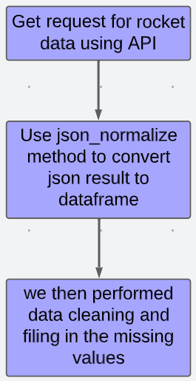
Data Collection – SpaceX API
Data can be obtained from SpaceX API , this data is collected by a API request. The data is cleaned and formatting.
https://github.com/PanchitoAureo/Applied-Data-Science-Capstone-IBM-data-science-professional-certificate/blob/main/jupyter-labs-spacex-data-collection-api%20(3).ipynb

Slide 9
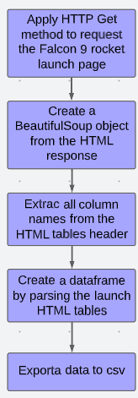
Data Collection - Scraping
Webscraping is applied to Wikipedia page, we recollect only the data from Falco 9 with beatifulSoup. The table is converted into a pandas dataframe.
https://github.com/PanchitoAureo/Applied-Data-Science-Capstone-IBM-data-science-professional-certificate/blob/main/jupyter-labs-webscraping%20(1).ipynb

Slide 10
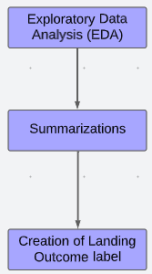
Data Wrangling
On the data ser was performed Exploratory Data Analysis (EDA)
Calculated the number of launches per site and occurrence and number of each orbits
Create a outcome label from outcome column and export the results to csv
https://github.com/PanchitoAureo/Applied-Data-Science-Capstone-IBM-data-science-professional-certificate/blob/main/jupyter-labs-webscraping%20(1).ipynb

Slide 11
EDA with Data Visualization
Summarize what charts were plotted and why you used those charts
We used Catplot because the variables show the relationship between a numerical and one or more categorical variables using one of several visual representations. We used Catplot to visualize the relationship between:
Flight Number vs Payload.
Flight Number vs Launch.
Flight Number vs Orbit type.
Payload vs Launch Site.
Payload vs Orbit Type.
We Used BarChart to visualize the relationship between each Orbit type.
We Used Line Chart to visualize the launches success yearly trend.
https://github.com/PanchitoAureo/Applied-Data-Science-Capstone-IBM-data-science-professional-certificate/blob/main/EDA%20with%20Data%20Visualization.ipynb
https://github.com/PanchitoAureo/Applied-Data-Science-Capstone-IBM-data-science-professional-certificate/blob/main/EDA%20with%20Data%20Visualization.ipynb

Slide 12
EDA with SQL
SQL queries performed:
Display the names of the unique launch sites in the space mission: SELECT DISTINCT(launch_site) FROM SPACEXTBL;
Display 5 records where launch sites begin with the string ‘CCA’: SELECT * FROM SPACEXTBL WHERE launch_site LIKE 'CCA%' LIMIT 5;
Display the total payload mass carried by boosters launched by NASA (CRS): SELECT SUM(payload mass __kg )AS TOTAL_PAYLOAD_ MASS FROM SPACEXTBL WHEREcustomer="NASA (CRS);
Display average payload mass carried by booster version FO v1.1: SELECT AVG{(payload_mass__kg_) AS AVG_PAYLOAD_MASS FROM SPACEXTBL WHEREbooster_version="F9v1.1’;
List the date when the first successful landing outcome in ground pad was achieved: SELECT MIN(DATE) AS first_successful_landing FROM SPACEXTBL WHERE (landing _outcome)=Successrae)
https://github.com/PanchitoAureo/Applied-Data-Science-Capstone-IBM-data-science-professional-certificate/blob/main/EDA%20with%20SQL%20lab.ipynb

Slide 13
Build an Interactive Map with Folium
Summary of map objects that were created and added to the Folium map
folium.Circle and folium.Marker to add a highlighted circle area with a text label on a specific coordinate for each launch site on the site map.*
MarkerCluster object for simplify a map containing many markers having the same coordinate.
MousePosition on the map to get coordinate for a mouse over a point on the map.
folium.PolyLine object to draw a line between a launch site to its closest city, railway and highway.
https://github.com/PanchitoAureo/Applied-Data-Science-Capstone-IBM-data-science-professional-certificate/blob/main/lab_jupyter_launch_site_location.jupyterlite.ipynb

Slide 14
Build a Dashboard with Plotly Dash
In this section, an interactive dashboard will be shown where the launch percentages for different launch sites will be graphed. One pie chart will be displayed for all sites and one figure for each site.
In addition, a scatter plot will be shown where different booster combinations are bought with their payload mass.
The importance of the pie charts is that they quickly allow us to see which launch site has the highest and lowest success rate. The scatter plot allows us to know which booster combination is the most effective and also in which weight ranges the shots are successful.
https://github.com/PanchitoAureo/Applied-Data-Science-Capstone-IBM-data-science-professional-certificate/blob/main/spacex_dash_app.py

Slide 15
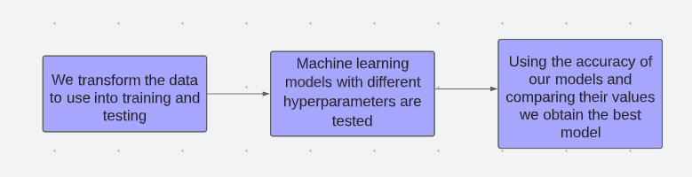
We loaded the data and transformed to use in our training and testing with different model of machine learning (logistic regression, support vector machine, decision tree and k nearest neighbors), to this we use GridSearchCV with various hyperparameters. We used accuracy of ours models to compare their values and obtain the best model.
https://github.com/PanchitoAureo/Applied-Data-Science-Capstone-IBM-data-science-professional-certificate/blob/main/SpaceX_Machine_Learning_Prediction_Part_5.jupyterlite.ipynb
Predictive Analysis (Classification)

Slide 16
Results
Exploratory data analysis results
Interactive analytics demo in screenshots
Predictive analysis results

Slide 17

Section 2

Slide 18
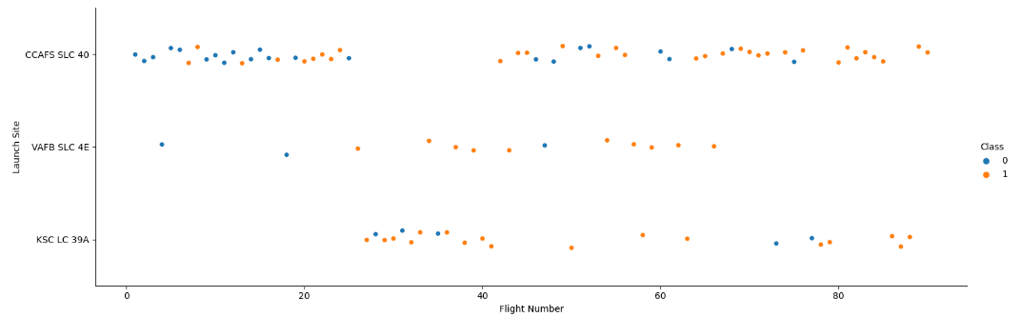
Flight Number vs. Launch Site
The launch site is CCAF5 SLC40 concentrated the majority of the launches
The launch site is CCAF5 SLC40 has the worst ratio of successful
The successful rate has increased for every Launch Site

Slide 19
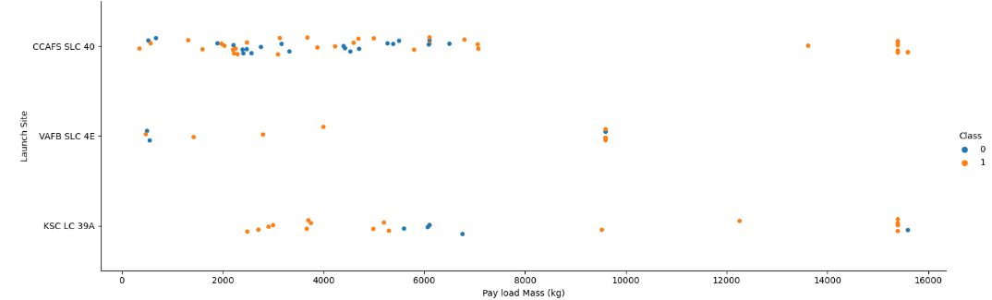
Payload vs. Launch Site
Under 8000 kg concentrated the majority of the launches.
Over 9000 kg the launches has the best ratio of successful.

Slide 20
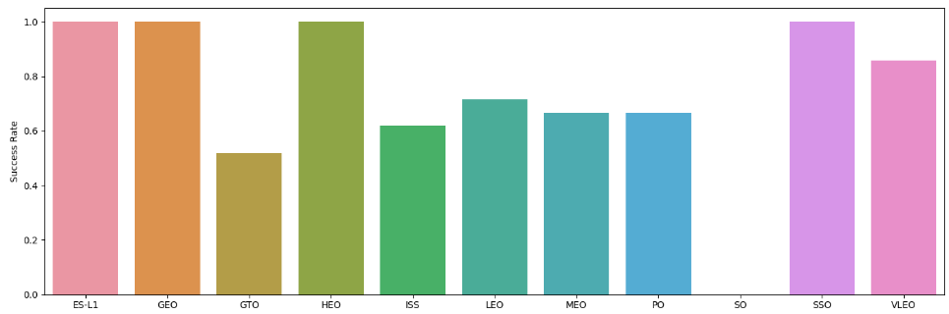
Success Rate vs. Orbit Type
The biggest success ratios happens to orbits ES-L1, GEO, HEO and SSO.
The lowest success ratios happens to orbit GTO.

Slide 21
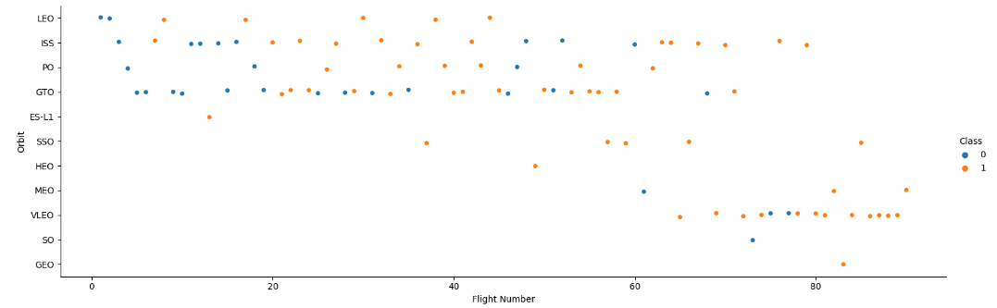
Flight Number vs. Orbit Type
The lowest success ratios happens to orbits GTO and ISS
The lowest success ratios happens in the beginning of the Fligth numbers, After the 40 Launches the ratio of successful grow up.

Slide 22
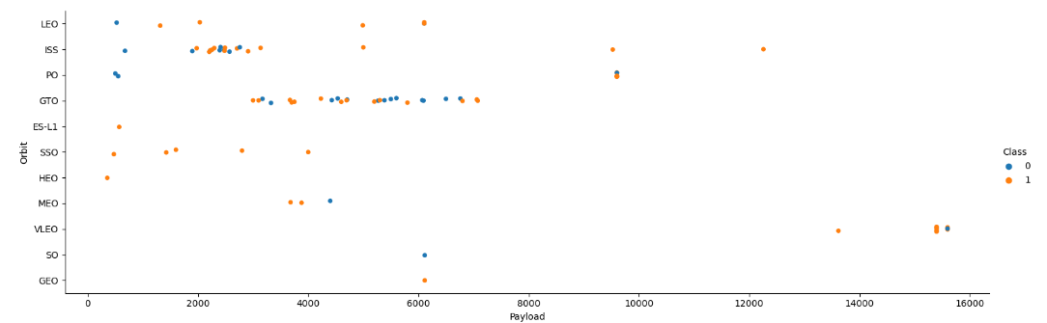
Payload vs. Orbit Type
Over 9000 kg the launches has the best ratio of successful.
Apparently, there is no relation between payload and success rate to orbit GTO.
There are one launch to the orbits SO and GEO.

Slide 23
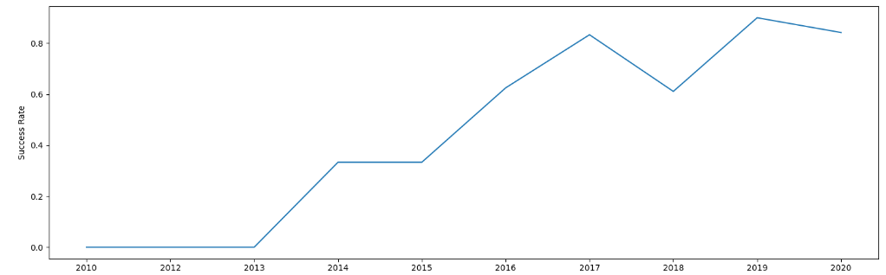
Launch Success Yearly Trend
Success rate started increasing in 2013 and kept until 2020.
the first 3 years failed the vast majority of launches.
In year 2018 was the only down on the success rate.

Slide 24
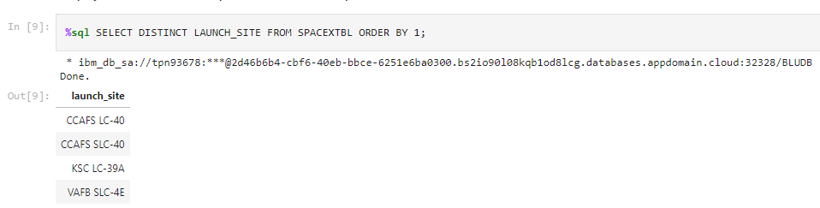
All Launch Site Names
There are four launchsites
The command DISTINCT show only unique launch sites from the SpaceX data.

Slide 25
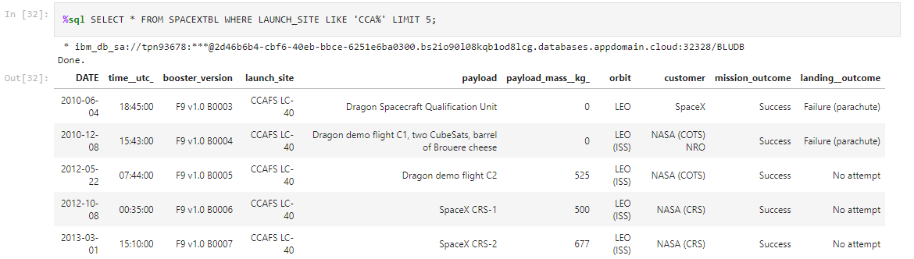
Launch Site Names Begin with 'CCA'
We used querys like WHERE , LIKE and LIMIT

Slide 26
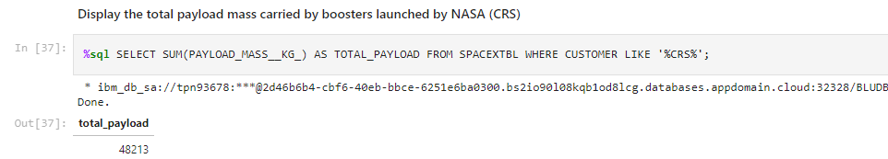
Total Payload Mass
We used querys like SUM (summarized) AS (give a name to SUM variable),, WHERE, LIKE
The total payload mass carried by boosters launches by NASA (CRS) was 48123 KG

Slide 27
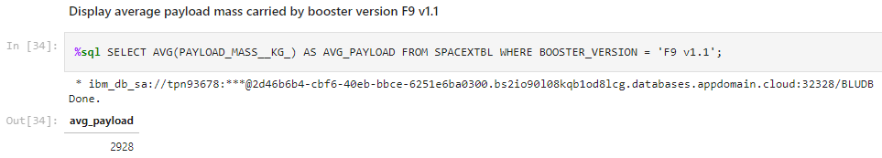
Average Payload Mass by F9 v1.1
The average payload mass carried by booster version F9 v1.1 is 2928 KG
We used querys like AVG (Average) AS (give a name to AVG variable), FROM , WHERE

Slide 28
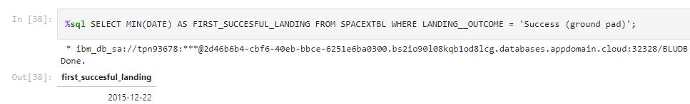
First Successful Ground Landing Date
The dates of the first successful landing outcome on ground pad was 2015-12-22
We used querys like MIN(Minimum) AS (give a name to MIN variable), FROM , WHERE

Slide 29
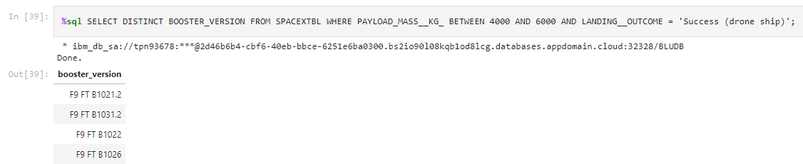
Successful Drone Ship Landing with Payload between 4000 and 6000
The names of boosters which have successfully landed on drone ship and had payload mass greater than 4000 but less than 6000 was F9 FT B1021.2, F9 FT B1031.2, F9 FT B1022 and F9 FT B1026
We used querys like DISTINCT (show only unique variable), FROM , WHERE, BETWEEN (used to test whether an expression is within a range of values)

Slide 30
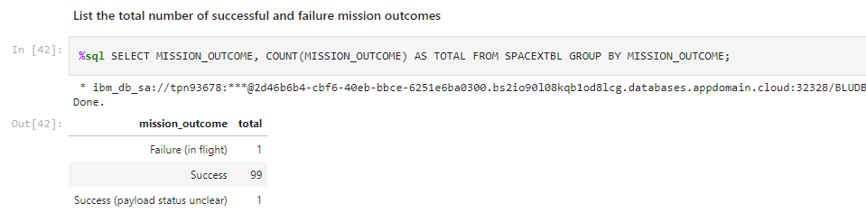
Total Number of Successful and Failure Mission Outcomes
The total number of successful is 99 and failure mission outcomes is 1
We used querys like COUNT() AS (give a name to MIN variable), FROM , GROUP BY

Slide 31
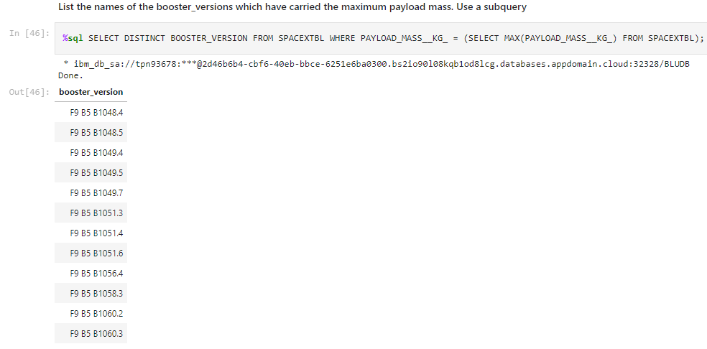
Boosters Carried Maximum Payload
We used subquerys and querys like DISTINCT (show only unique variable), FROM , WHERE, BETWEEN (used to test whether an expression is within a range of values)
The names of the booster which have carried the maximum payload mass is:

Slide 32
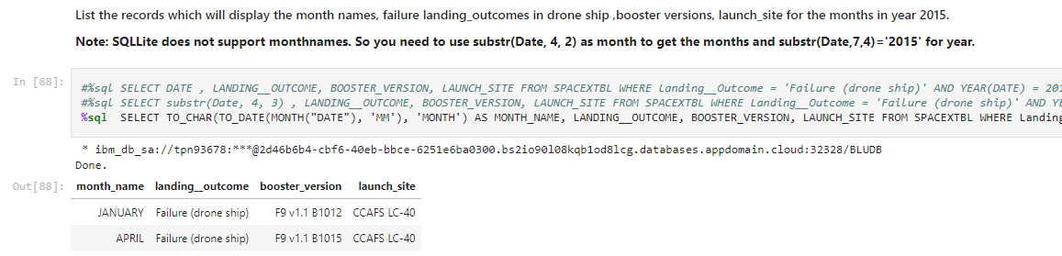
2015 Launch Records
We used subquerys and querys like TO_DATE, WHERE
The failed landing_outcomes in drone ship, their booster versions, and launch site names for in year 2015 is:

Slide 33
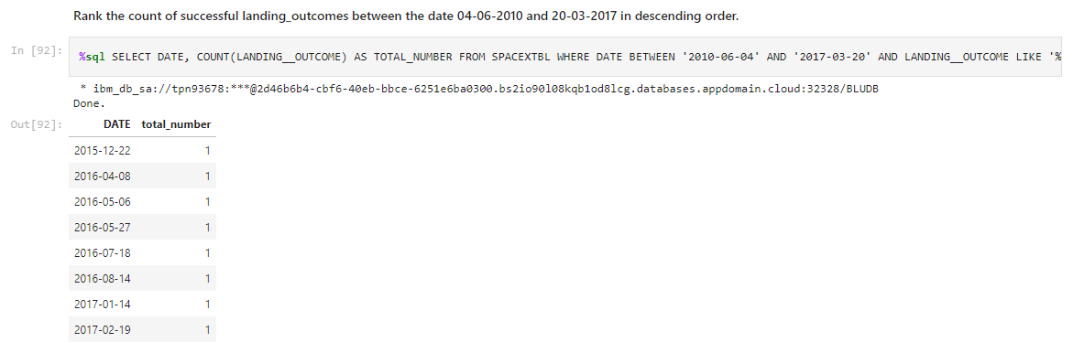
Rank Landing Outcomes Between 2010-06-04 and 2017-03-20
The count of successful landing outcomes between the date 04-06-2010 and 20-03-2017 in descending order is:
Present your query result with a short explanation here

Slide 34

Section 3

Slide 35
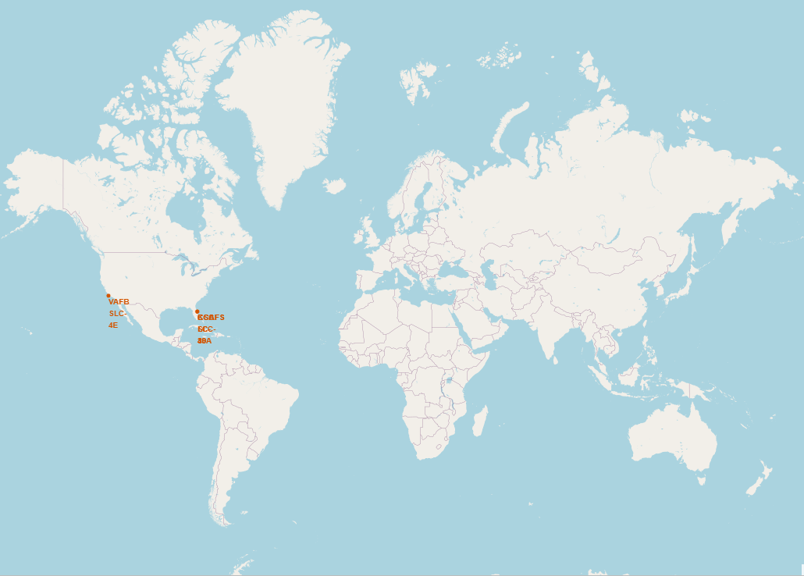
All launch sites
Lauch cities are near the sea.
All launch sites are in USA.

Slide 36
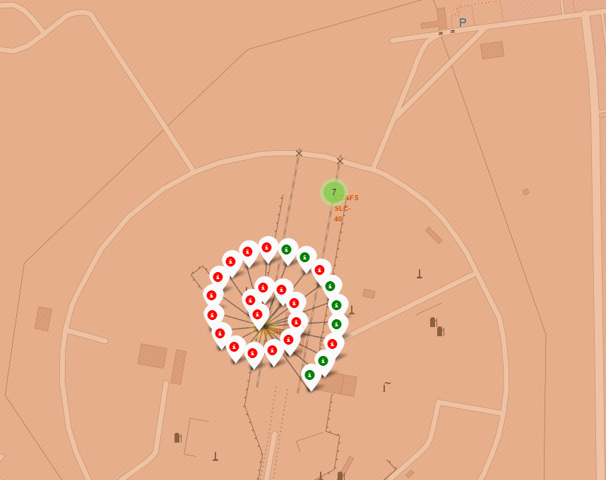
Markers showing launch sites with color labels
Example of CCAFS SLC 40 and CCAFS LC 40 launch sites and launch outcomes.
Green Marker shows successful Launches and Red Marker shows Failures.

Slide 37
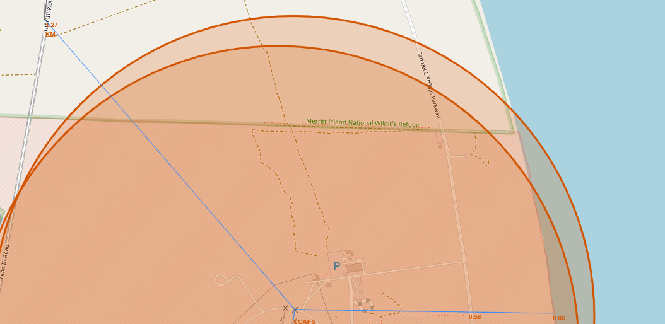
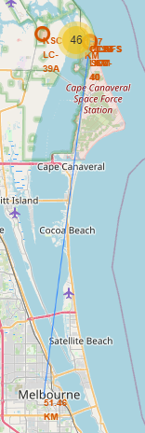
Launch Site distance to landmarks
In CCAFS SLC 40 and CCAFS LC 40 launch sites to its proximities such as railway, highway, coastline, with distance calculated and displayed

Slide 38

Section 4

Slide 39
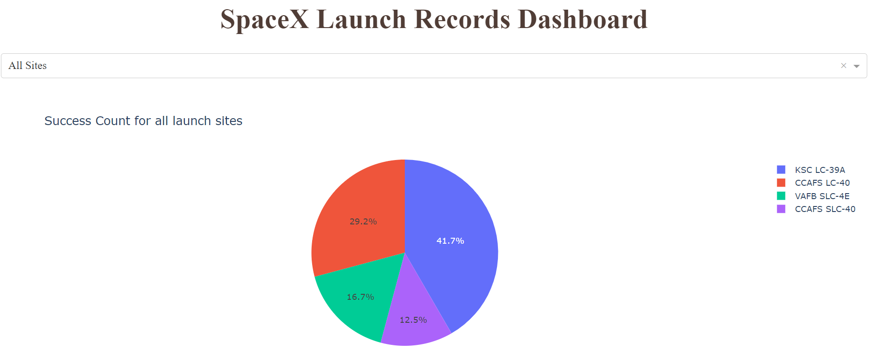
Launch success count for all sites
In the figure show launch success count for all sites, in a pie chart.
The importance of the graph shown is that we can make a quick comparison of which launch site has the highest and lowest launch success.

Slide 40
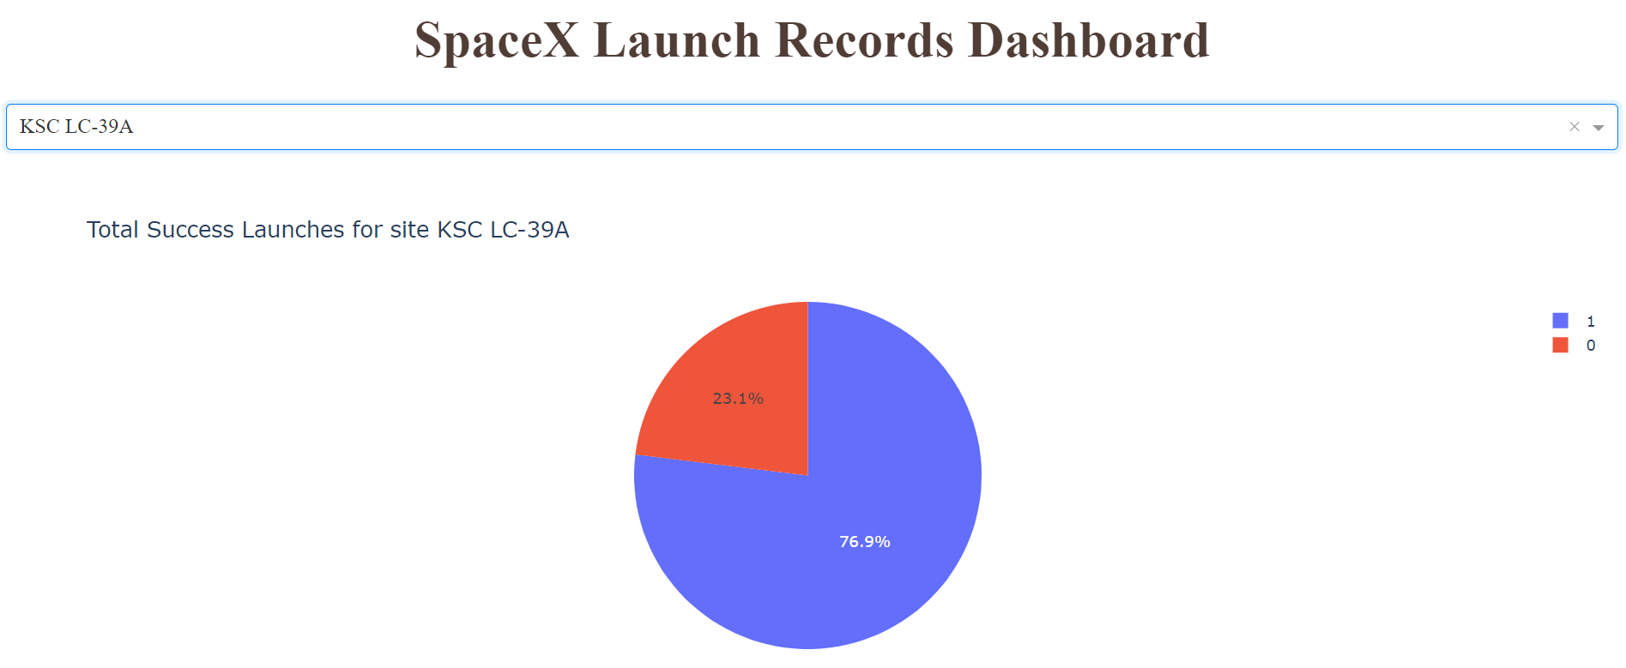
Highest Launch success is KSCLC-39A
In the figure show launch success count for site KSCLC-39A, in a pie chart.
The graph shows the percentage of successful launch (1) vs failed launch (0). This launch site is the one with the highest success rate with 76.9%

Slide 41
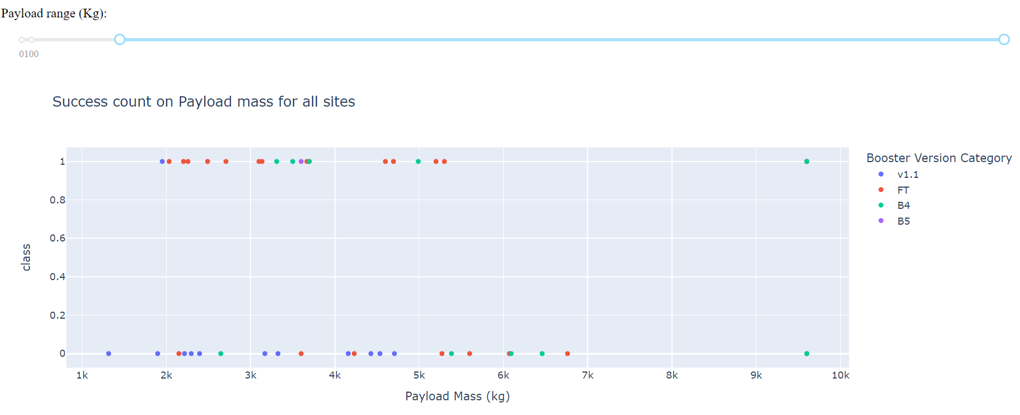
Payload vs. Launch Outcome
In the figure show a Payload vs. Launch Outcome scatter plot for all sites, with different payload selected in the range slider
The importance of this figure is that we can conclude that the vast majority of rockets to have a successful launch must weigh less than 6000 kg. It is also appreciated that the most successful combination is the FT boosters

Slide 42

Section 5

Slide 43
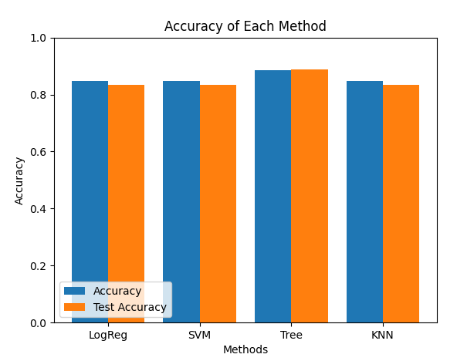
Classification Accuracy
Here we visualize the built model accuracy for all built classification models, in a bar chart
The tree model has 88% of accuracy, this is the highest classification accuracy

Slide 44
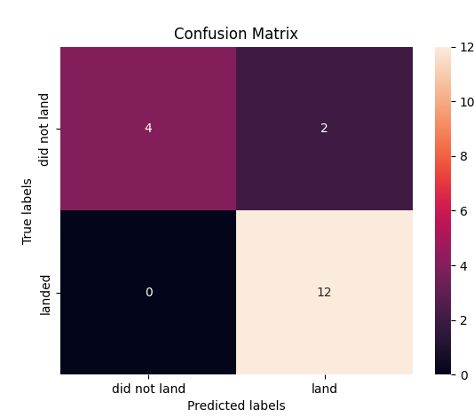
Confusion Matrix
Confusion matrix of Decision Tree Classifier give us the big accuracy, showing the big numbers of true positive and true negative compared to the false ones.

Slide 45
Conclusions
We can conclude that:
The larger the flight amount at a launch site, the greater the success rate at a launch site.
Launch success rate started to increase in 2013 till 2020.
Orbits ES-L1, GEO, HEO, SSO, VLEO had the most success rate.
KSC LC-39A had the most successful launches of any sites.
The Decision tree classifier is the best machine learning algorithm for this task.

Slide 46


